Slide 1

Generalized Policy Iteration
Notes:
1

Slide 2
Objectives
Understand the framework of generalized policy iteration
Understand the distinction between synchronous and asynchronous dynamic programming methods
2
Generalized Policy Iteration
Notes:
2

Slide 3
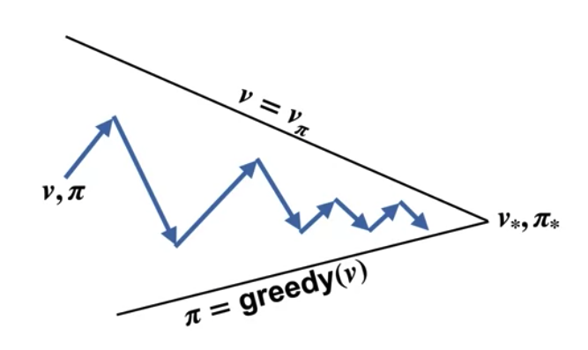
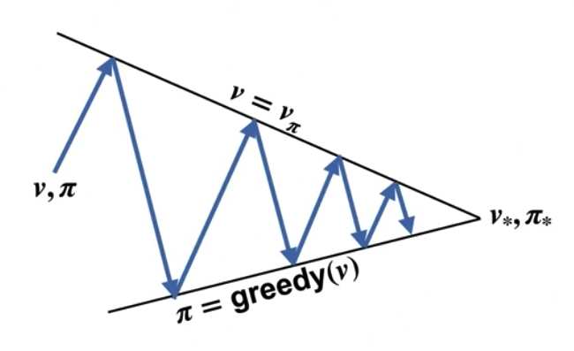
Generalized Policy Iteration
Generalized Policy Iteration (GPI) is a framework in reinforcement learning (RL) that unifies various algorithms for policy evaluation and improvement.
It aims to find an optimal policy by iteratively updating policies and value functions in a coordinated manner.
3
Generalized Policy Iteration
Notes:
3

Slide 4
Generalized Policy Iteration
The key idea behind GPI is to alternate between two main processes:
Policy Evaluation: the current policy is evaluated to estimate its value function. The value function represents the expected cumulative reward obtained by following the policy from each state.
4
Generalized Policy Iteration
Notes:
4

Slide 5
Generalized Policy Iteration
Policy Improvement: After evaluating the current policy, the agent attempts to improve it by selecting actions that are expected to yield higher rewards.
These two steps are repeated iteratively, with each iteration potentially improving the overall policy until convergence is achieved.
5
Generalized Policy Iteration
Notes:
5

Slide 6
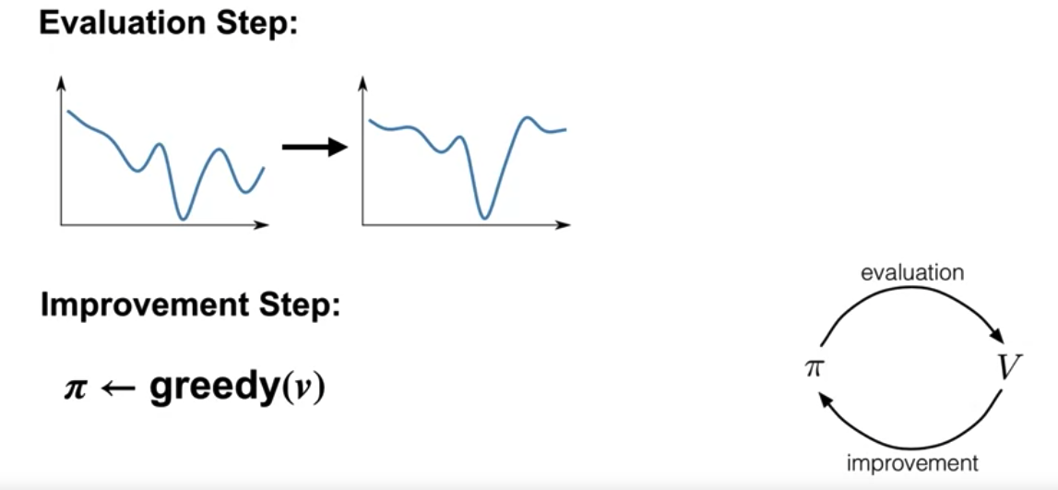
Value Iteration
We still sweep over all the states and greedify with respect to the current value function. However, we do not run policy evaluation to completion. We perform just one sweep over all the states. After that, we greedify again.
6
Generalized Policy Iteration
Notes:
6

Slide 7
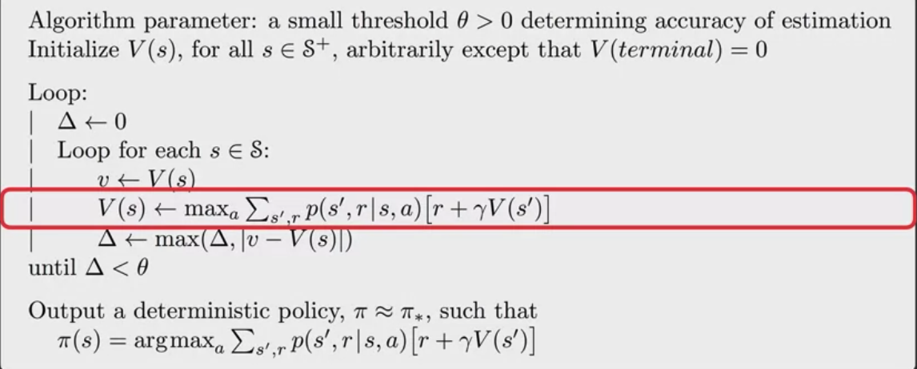
Value Iteration
Value Iteration for estimating p~ p*
7
Generalized Policy Iteration
Notes:
7

Slide 8
Dynamic Programming
Synchronous Dynamic Programming:
The value functions are updated simultaneously for all states or state-action pairs in each iteration.
The updates are synchronized across all states or state-action pairs.
Value iteration, which is a classic dynamic programming algorithm for finding optimal value functions.
8
Generalized Policy Iteration
Notes:
8

Slide 9
Dynamic Programming
Synchronous Dynamic Programming:
Synchronous dynamic programming can be computationally efficient when implemented in environments with a relatively small number of states or state-action pairs.
9
Generalized Policy Iteration
Notes:
9

Slide 10
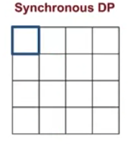
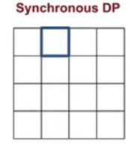
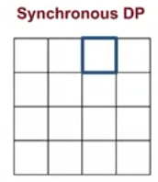
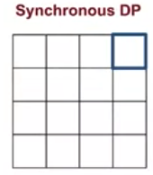
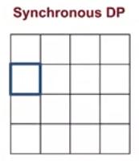
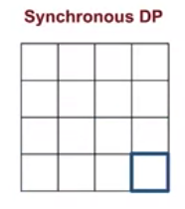
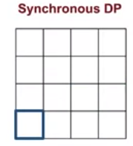
Dynamic Programming
Synchronous DP: Value iteration sweeps the entire state space on each iteration just like policy iteration
……………….
……………….
10
Generalized Policy Iteration
Notes:
10

Slide 11
Dynamic Programming
Asynchronous Dynamic Programming:
The value functions are updated one at a time, either randomly or according to some specific order.
The updates are not synchronized across states or state-action pairs, and each update may use the most recent value estimates available at the time.
It is particularly useful when dealing with large-scale or continuous-state spaces, where updating all values simultaneously may be computationally infeasible.
11
Generalized Policy Iteration
Notes:
11

Slide 12
Dynamic Programming
Asynchronous Dynamic Programming:
There are various strategies for selecting which values to update and in what order, such as prioritized sweeping, TD(λ), or online Q-learning.
Asynchronous dynamic programming methods often exhibit more flexibility and scalability compared to synchronous methods but may require careful tuning of update schedules and convergence criteria.
12
Generalized Policy Iteration
Notes:
12

Slide 13
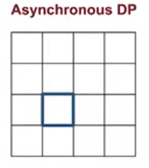
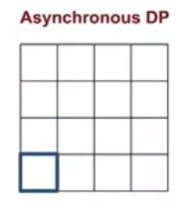
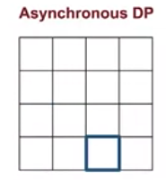
Dynamic Programming
Asynchronous dynamic programming algorithms update the values of states in any order, they do not perform systematic sweeps.
13
Generalized Policy Iteration
Notes:
13

Slide 14
Summary
Understand the framework of generalized policy iteration
Understand the distinction between synchronous and asynchronous dynamic programming methods
14
Generalized Policy Iteration

Slide 15
Q & A
15
Generalized Policy Iteration

